Slide 1

Groups (cont.)

Slide 2
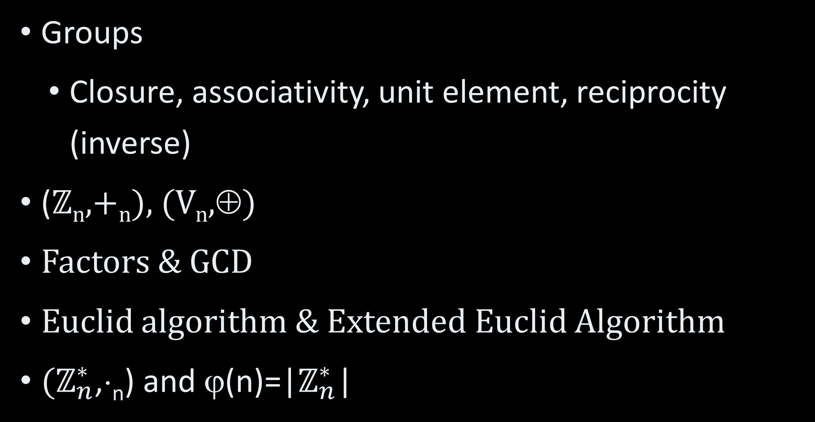
In the Previous Lesson
Groups
Closure, associativity, unit element, reciprocity (inverse)
(ℤ_{n},+_{n}), (V_{n},⊕)
Factors & GCD
Euclid algorithm & Extended Euclid Algorithm
($ℤ_{n}^{∗}$,⋅_{n}) and ϕ(n)=|$ℤ_{n}^{∗}$|

Slide 3
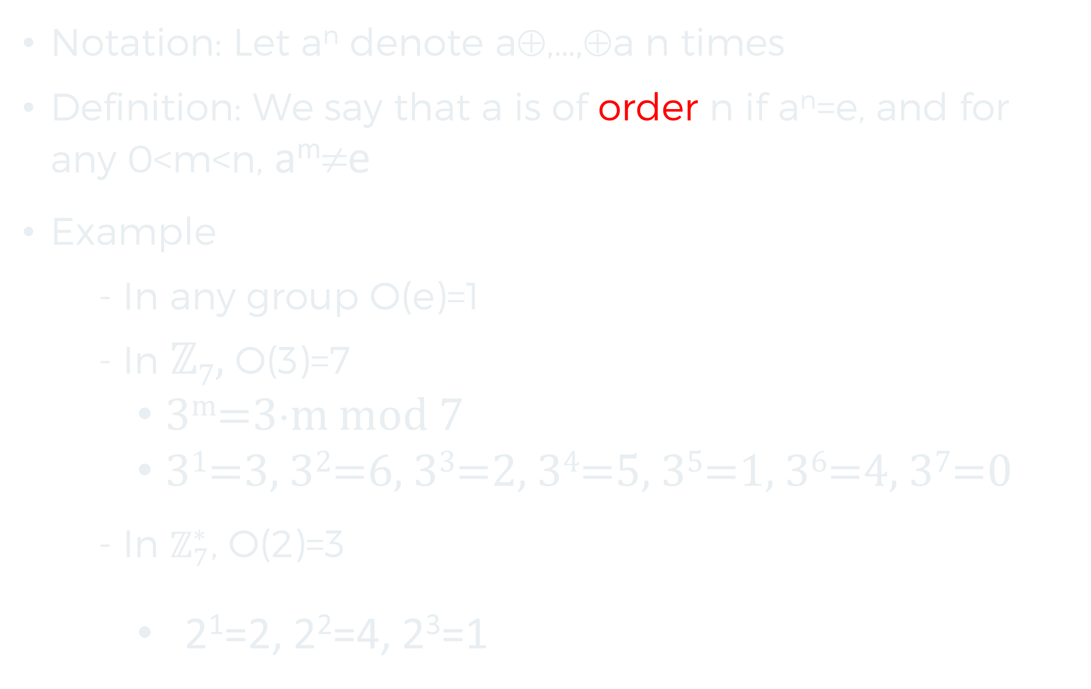
Order of Elements I
Notation: Let a^{n} denote a⊕,…,⊕a n times
Definition: We say that a is of order n if a^{n}=e, and for any 0<m<n, a^{m}≠e
Example
- In any group O(e)=1
- In ℤ₇, O(3)=7
3^{m}=3⋅m mod 7
3¹=3, 3²=6, 3³=2, 3⁴=5, 3⁵=1, 3⁶=4, 3⁷=0
- In $ℤ_{7}^{∗}$, O(2)=3
2¹=2, 2²=4, 2³=1

Slide 4
Order of Elements II
Theorem: Let (G, ⊕) be a finite group and g be an element of the group. Then the order of g ≤ |G| (in fact , g^{|G|}=e, see Lagrange theorem).
Corollary: in the multiplicative group of Z_{n} any element is of order at most φ(n)

Slide 5
Proof
Consider g⁰,g¹,g²,…g^{|G|}
Closure {g⁰,g¹,g²,…g^{|G|}}⊆G
Pigeonhole principle
- ➔ ∃0≤j<k≤|G|, g^{j}=g^{k}
Multiply by g⁻¹➔ g^{j-1}=g^{k-1}
Repeat ➔ e=g⁰=g^{k-j}
0<k-j≤|G|
➔0<O(g)≤k-j

Slide 6
Sub-Groups I
Definition: Let (G,⊕) be a group. (H,⊕) is a sub-group of (G,⊕) if it is a group, and H⊆G.
Claim: If (G,⊕) is a finite group and (H,⊕) is closed, where ∅≠H⊆G, then (H,⊕) is a sub-group of (G,⊕).
Proof sketch:
Associativity – inherited from group
Unit element – closure means that if g∈H, then g^{m}∈H for all m ➔e=g^{O(g)}∈H.
Inverse of g: g^{O(g)-1}

Slide 7
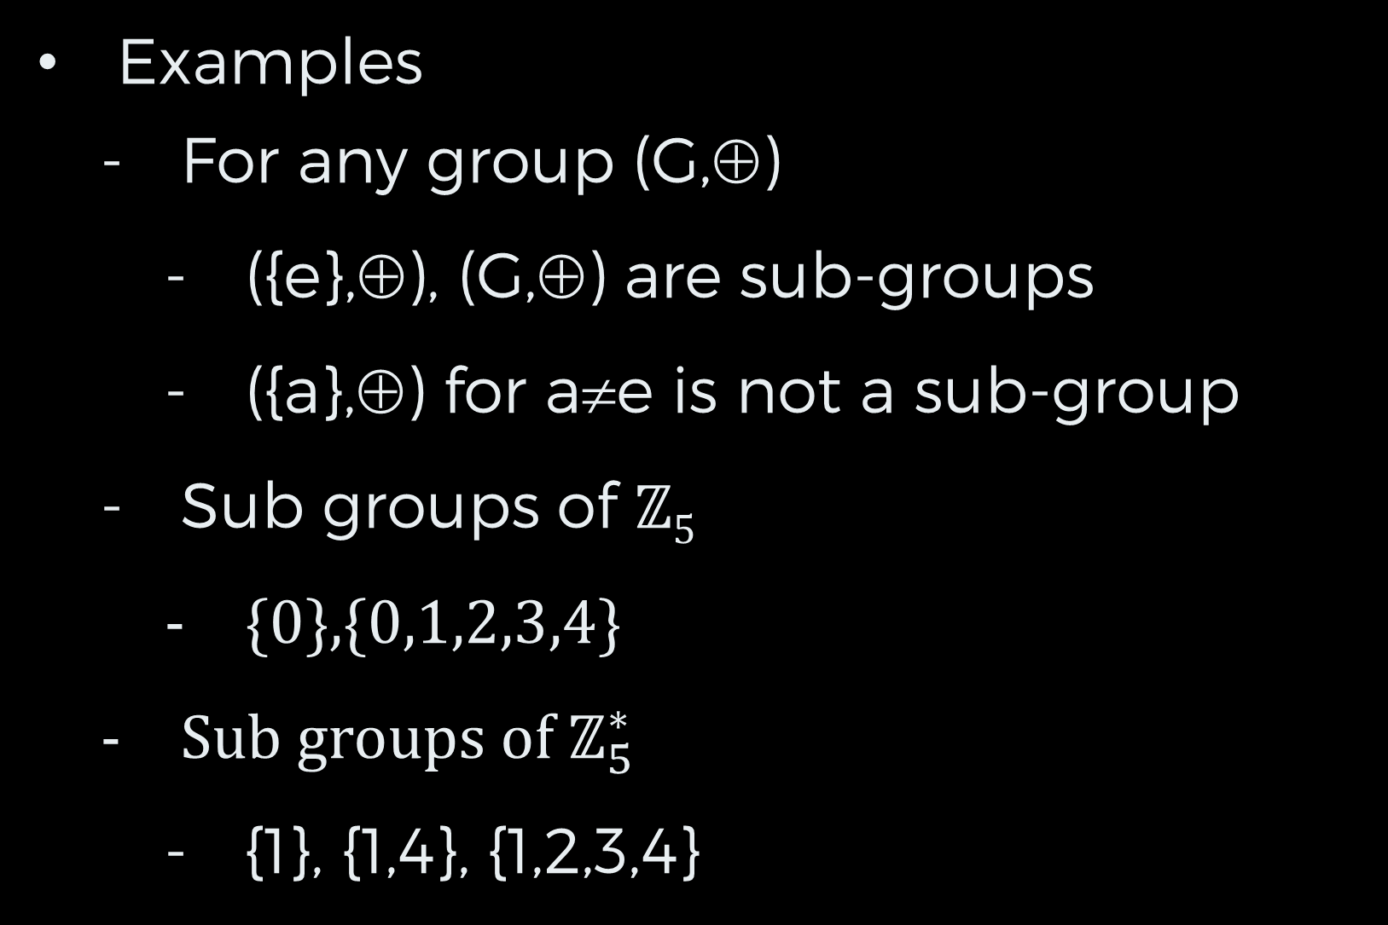
Sub-Groups II
Examples
For any group (G,⊕)
({e},⊕), (G,⊕) are sub-groups
({a},⊕) for a≠e is not a sub-group
Sub groups of ℤ₅
{0},{0,1,2,3,4}
Sub groups of $ℤ_{5}^{∗}$
{1}, {1,4}, {1,2,3,4}

Slide 8
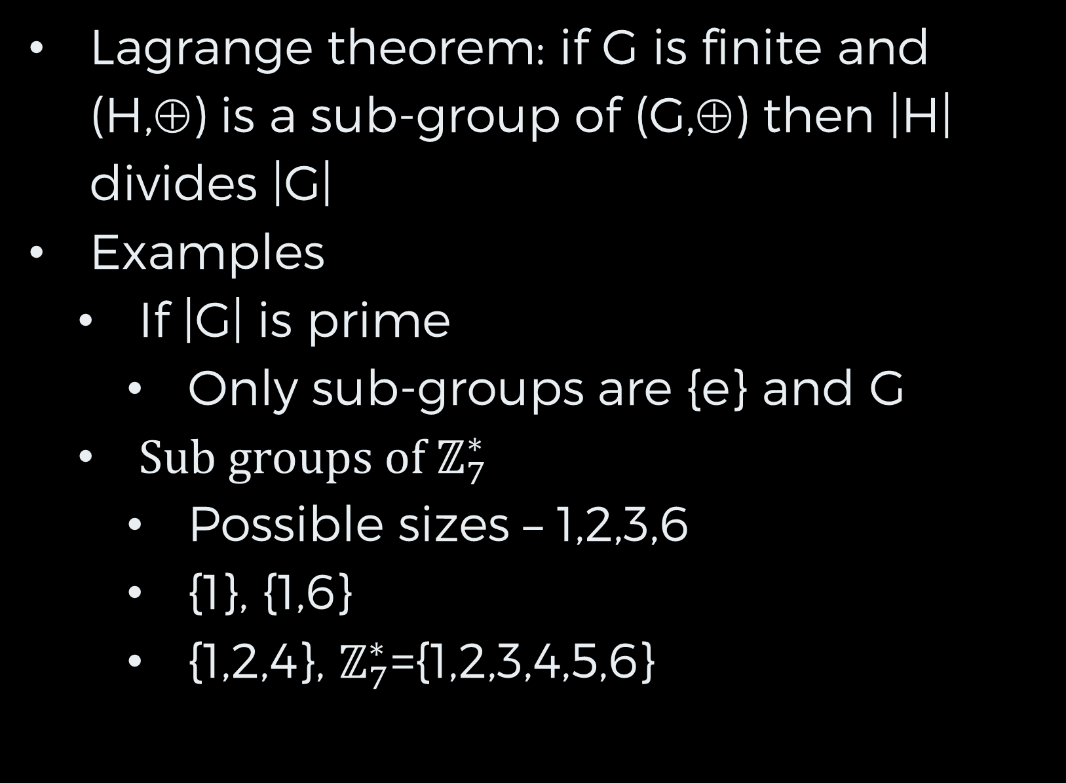
Sub-Groups III
Lagrange theorem: if G is finite and (H,⊕) is a sub-group of (G,⊕) then |H| divides |G|
Examples
If |G| is prime
Only sub-groups are {e} and G
Sub groups of $ℤ_{7}^{∗}$
Possible sizes – 1,2,3,6
{1}, {1,6}
{1,2,4}, $ℤ_{7}^{∗}$={1,2,3,4,5,6}

Slide 9
Generators
Notation: Let (G,⊕) be a finite group, [a]={e,a,a²,a³,…,a^{O(a)-1}}
Claim: ([a],⊕) is a sub-group of (G,⊕).
Proof:
Let a^{j}, a^{i} ∈[a] ➔ 0≤i,j<O(a)
If i+j<O(a) then a^{i+j}∈[a]
If i+j≥O(a) then 0≤i+j-O(a)<O(a) and
a^{i+j}=a^{O(a)+(i+j-O(a))}=a^{O(a)}⊕a^{i+j-O(a)}
=e⊕a^{i+j-O(a)}=a^{i+j-O(a)}∈[a]
Definitions: a is the generator of [a], and [a] is the subgroup generated by a

Slide 10
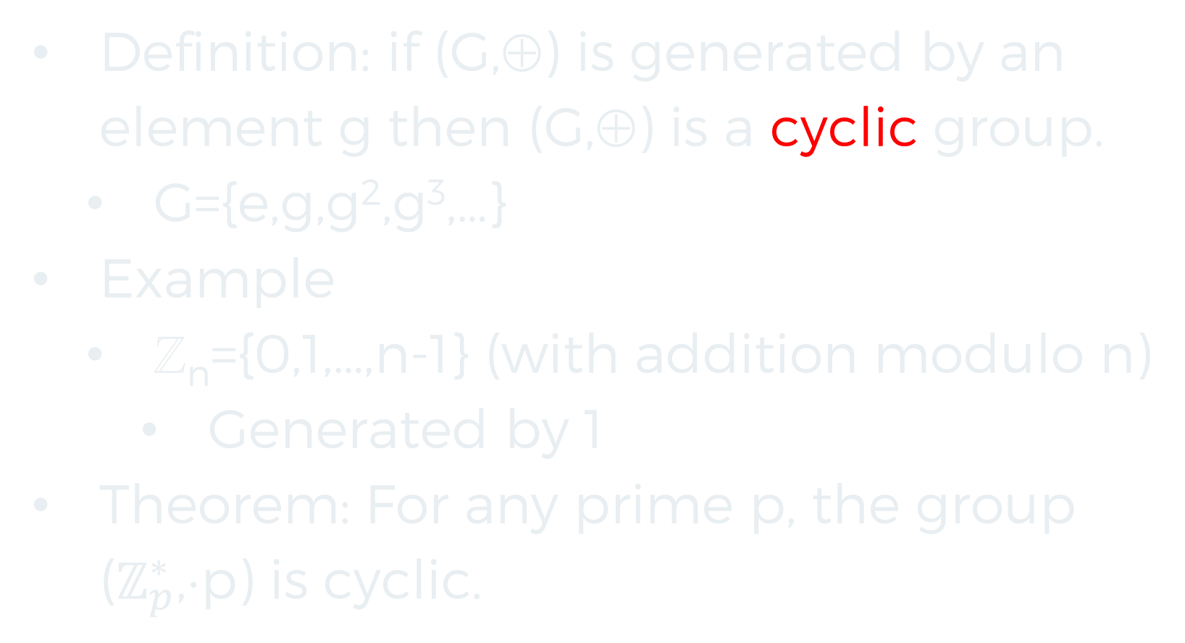
Cyclic Groups I
Definition: if (G,⊕) is generated by an element g then (G,⊕) is a cyclic group.
G={e,g,g²,g³,…}
Example
ℤ_{n}={0,1,…,n-1} (with addition modulo n)
Generated by 1
Theorem: For any prime p, the group ($ℤ_{p}^{∗}$,⋅p) is cyclic.

Slide 11
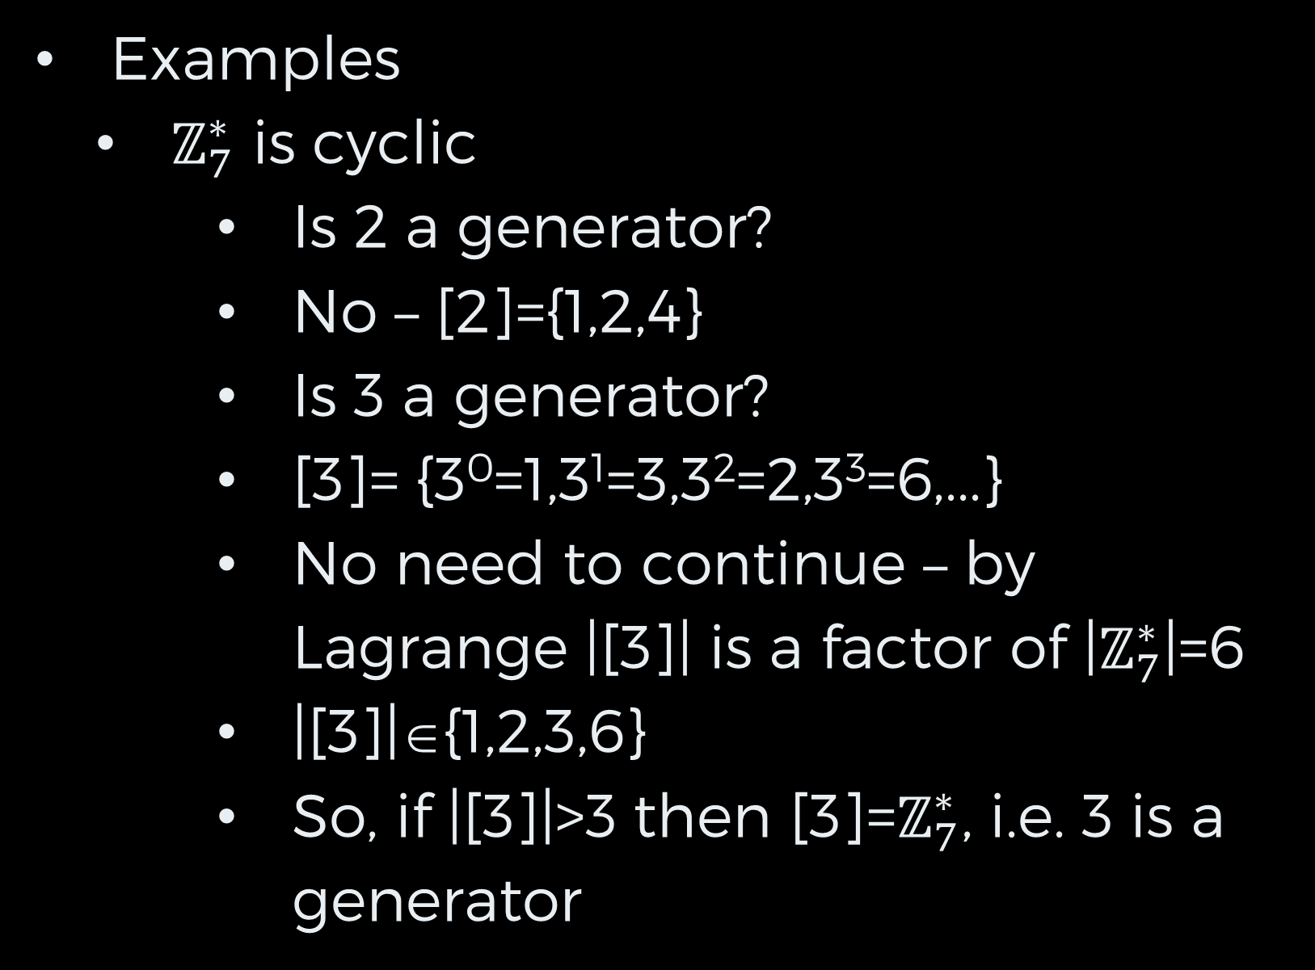
Cyclic Groups II
Examples
$ℤ_{7}^{∗}$ is cyclic
Is 2 a generator?
No – [2]={1,2,4}
Is 3 a generator?
[3]= {3⁰=1,3¹=3,3²=2,3³=6,...}
No need to continue – by Lagrange |[3]| is a factor of |$ℤ_{7}^{∗}$|=6
|[3]|∈{1,2,3,6}
So, if |[3]|>3 then [3]=$ℤ_{7}^{∗}$, i.e. 3 is a generator

Slide 12
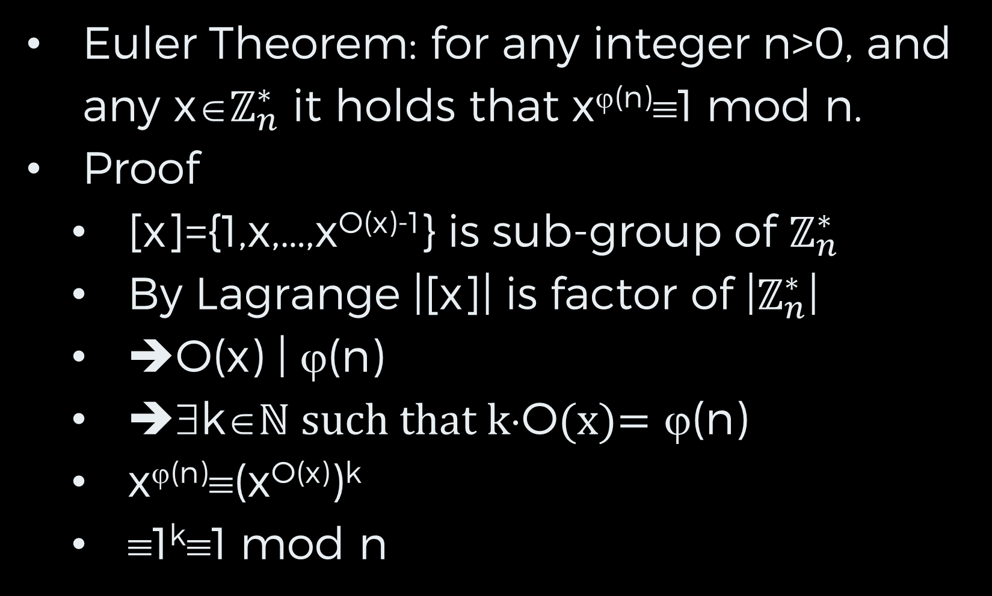
Cyclic Groups III
Euler Theorem: for any integer n>0, and any x∈$ℤ_{n}^{∗}$ it holds that x^{ϕ(n)}≡1 mod n.
Proof
[x]={1,x,…,x^{O(x)-1}} is sub-group of $ℤ_{n}^{∗}$
By Lagrange |[x]| is factor of |$ℤ_{n}^{∗}$|
➔O(x) | ϕ(n)
➔∃k∈ℕ such that k⋅O(x)= ϕ(n)
x^{ϕ(n)}≡(x^{O(x)})^{k}
≡1^{k}≡1 mod n

Slide 13
Rings & Fields

Slide 14
Rings I
Definition: A ring <R,⊕,⊗> has the following properties:
<R,⊕> is a commutative group, identity 0
<R,⊗> is closed, associative, identity 1
⊗ is distributive: a⊗(b⊕c)=(a⊗b)⊕(a⊗c) and (b⊕c)⊗a=(b⊗a)⊕(c⊗a)
A ring is called commutative if ⊗ is a commutative operation
Examples of rings
(ℤ,+,⋅), (ℤ_{n},+_{n},⋅_{n})

Slide 15
Rings II
Claim: 0 is a multiplicative annihilator in a ring (i.e. ∀r∈R, 0⊗r=r⊗0=0)
Proof
0 is additive unit element
➔0⊗r=(0⊕0)⊗r
By distributive law
0⊗r= 0⊗r ⊕ 0⊗r
0⊗r is a ring element and has additive inverse
By adding inverse to both sides
0⊗r=0

Slide 16
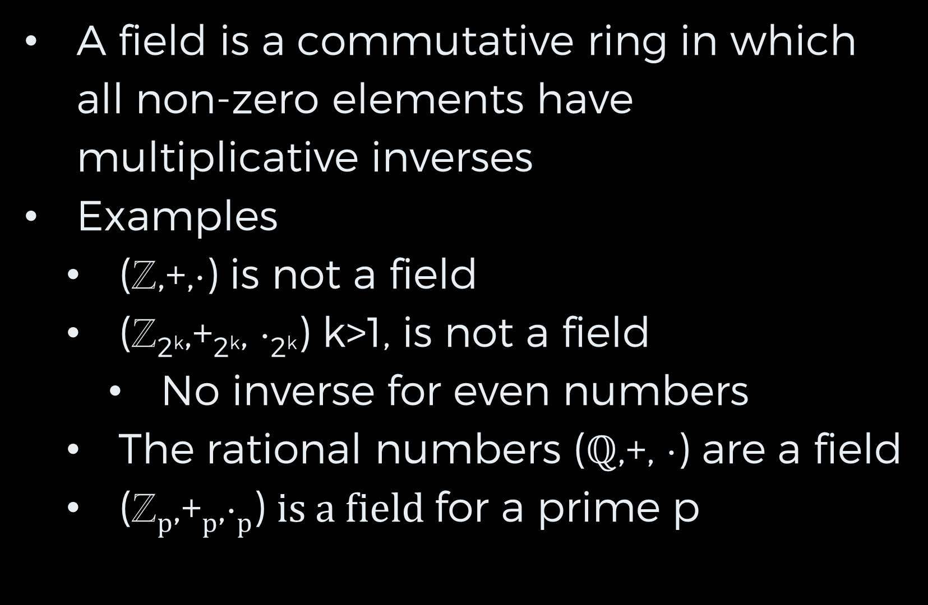
Fields I
A field is a commutative ring in which all non-zero elements have multiplicative inverses
Examples
(ℤ,+,⋅) is not a field
(ℤ_{2k},+_{2k}, ⋅_{2k}) k>1, is not a field
No inverse for even numbers
The rational numbers ($ℚ$,+, ⋅) are a field
(ℤ_{p},+_{p},⋅_{p}) is a field for a prime p

Slide 17
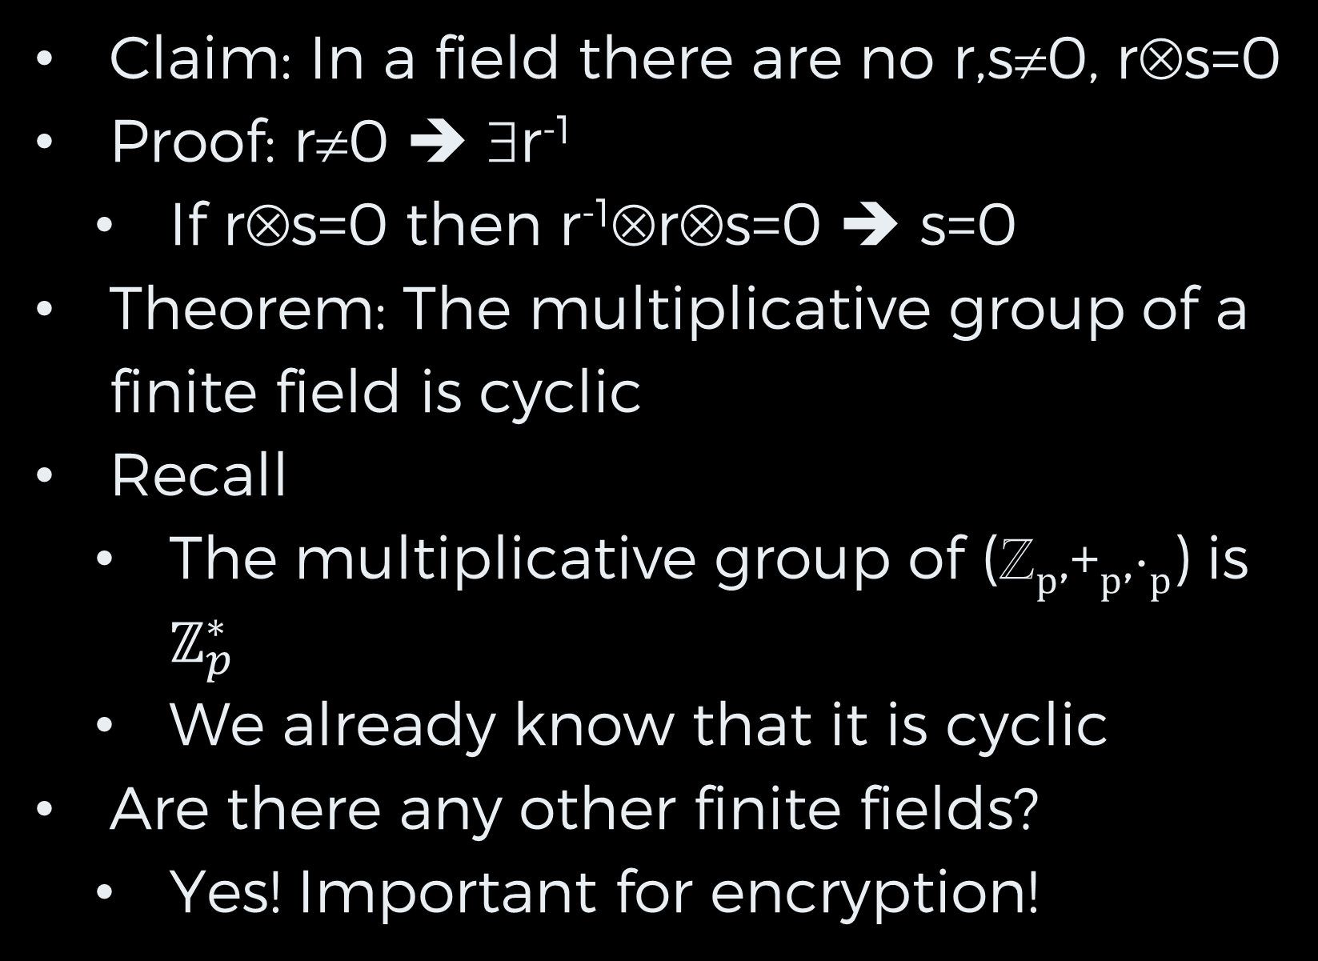
Fields II
Claim: In a field there are no r,s≠0, r⊗s=0
Proof: r≠0 ➔ ∃r⁻¹
If r⊗s=0 then r⁻¹⊗r⊗s=0 ➔ s=0
Theorem: The multiplicative group of a finite field is cyclic
Recall
The multiplicative group of (ℤ_{p},+_{p},⋅_{p}) is $ℤ_{p}^{∗}$
We already know that it is cyclic
Are there any other finite fields?
Yes! Important for encryption!

Slide 18
Polynomials I
A polynomial is an expression: a(x)=a_{m}x^{m}⊕…⊕a₀ over a commutative ring <R,⊕,⊗> (where x^{m} denotes x⊗…⊗x)
Polynomial degree: m
Two views of a polynomial
Function R→R
Input ring element r, output a(r)
Formal object

Slide 19
Polynomials II
Example of difference
Ring ℤ₂, polynomials a(x)=x, b(x)=x²
Identical as functions
Different as formal objects

Slide 20
Polynomial Ring I
Notation: R[x] – set of all polynomials over ring (R,⊕,⊗)
Let a(x), b(x)∈R[x]
a(x)=a_{m}x^{m}⊕…⊕a₀
b(x)=b_{m}x^{m}⊕…⊕b₀
Polynomial addition + defined by
c(x)=a(x)+b(x) then
c_{i}=a_{i}⊕b_{i}
Polynomial multiplication ⋅ defined by
c(x)=a(x) ⋅ b(x) then
c_{i}=a₀⊗b_{i} ⊕ a₁⊗b_{i-1} ⊕ … ⊕ a_{i}⊗b₀

Slide 21
Polynomial Ring II
Claim: (R[x],+,⋅) is a ring
Additive unit – 0 polynomial
Multiplicative unit – 1 polynomial
Name: polynomial ring over R
Example
ℤ[x]
Number of elements in ℤ[x]
Infinite

Slide 22
ℤ₂[x]
Degree 0 – 0, 1
Degree 1 – x, x+1
Degree 2 – x², x²+1, x²+x, x²+x+1
Degree 3 – 8 polynomials
Degree k – 2^{k} polynomials
|ℤ₂[x]| = ∞
Examples
(X⁴+x²+1) + (x⁴+x+1)= x²+x
(x²+x+1)(x+1)=x³+1

Slide 23
Polynomial Division I
Let F be a field
F[x] is the polynomial ring over F
Let g(x), h(x) ∈ F[x], h(x)≠0
Claim: There exist unique q(x), r(x) such that degree r(x)<degree h(x) and g(x)=q(x)h(x)+r(x)
Analog of integer division with residue

Slide 24
Polynomial Division II
Example:
Polynomial ring ℤ₂[x]
g(x)=x⁴+x+1, h(x)=x²+x+1
q(x)=x²
g(x)-q(x)h(x)=x³+x²+x+1
q(x)=x²+x
g(x)-q(x)h(x)=1
➔q(x)=x²+x, r(x)=1

Slide 25
Irreducible Polynomial I
Let F be a field
Definition: a polynomial g(x)∈F[x], such that h(x) is not a factor of g(x) for any h(x)∈R[x] with degree 0<deg(h(x))< deg(g(x)) is called irreducible.
Example
x⁴+x+1 is irreducible in ℤ₂[x]
But not in ℤ₃[x] !
Proof:
Method: divide x4+x+1 by any degree k polynomial 1≤k≤3
Check residue

Slide 26
Irreducible Polynomial II
Example (cont.):
Number of trial divisions: degree 1: 2 polynomials, degree 2: 4 poly, degree 3: 8 poly
2+4+8=14 trial divisions
If h(x) | x⁴+x+1 and degree h(x)=3 then
h(x)g(x)=x⁴+x+1 and degree g=1
➔ Check just deg. 1 + deg. 2 = 6 polynomials
If x|h(x) then h(0)=0
➔ x not a factor of x⁴+x+1

Slide 27
Irreducible Polynomial III
Example (cont.):
If x+1|h(x) then h(1)=0
➔ x+1 not a factor of x⁴+x+1
Leaves only degree 2 polynomials
x², x²+1=(x+1)², x²+x=x(x+1) and x²+x+1
First three are multiples of degree 1 polynomials
Need to check that x²+x+1 is not a factor of x⁴+x+1
Already checked! Residue 1
➔ x⁴+x+1 irreducible in ℤ₂[x]

Slide 28
F[x]/f(x) I
Definition: F[x]/f(x): includes all polynomials over field F of degree less than the degree of f(x). Addition and multiplication are computed modulo f(x)
Example: ℤ₂[x]/x⁴+x+1
Includes: 0, 1, x, x+1,…,x³+x²+x+1
(x³+x)+(x+1)=x³+1
(x³+x)(x+1) = x⁴+x³+x²+x
=x³+x²+1 mod x⁴+x+1

Slide 29
F[x]/f(x) II
Claim: F[x]/f(x) is a commutative ring for any f(x)
Additive unit – 0 polynomial
Multiplicative unit – 1 polynomial
Not all polynomials have inverses
Why not?
Polynomial GCD
If GCD(g(x),f(x)) of degree>0 then g(x) does not have an inverse in F[x]/f(x)

Slide 30
F[x]/f(x) III
Theorem: If f(x) is irreducible F[x]/f(x) is a field
Extended Euclid works for polynomials
Find inverse of g(x)∈F[x]/f(x) by running ext. Euclid on (g(x),f(x))
Output is a(x), b(x) such that a(x)g(x)+b(x)f(x)=GCD(f(x),g(x))=1

Slide 31
Galois Fields I
Two types of finite fields
Prime p
(ℤ_{p}={0,1,…,p-1},+_{p},⋅_{p})
Number of elements - p
Base field F (e.g. ℤ_{p}), f(x) irreducible in F[x]
F[x]/f(x), addition and multiplication modulo f(x)
Number of elements |F|^{degree f}
Theorem: any finite field has p^{n} elements for prime p and integer n≥0

Slide 32
Galois Fields II
Theorem: All finite fields with the same number of elements are identical up to isomorphism
Finite fields are often called Galois Fields.
Notation: GF(p^{n}), GF(p)=Z_{p}
Example: GF(2⁴) with irreducible poly. x⁴+x+1
The characteristic of a field F is the smallest p such that 1⊕…⊕1 p times is 0
Claim: In a finite field the characteristic is prime
The characteristic of GF(p^{n}) is p

Slide 33
Galois Fields III
More than one way to construct GF(p^{n}), n>1
Example: E=GF(2⁸)
Method I
Let f(x) have degree 8, irreducible over ℤ₂
E= ℤ₂[x]/f(x)
Elements: polynomials of degree < 8 with coefficients in ℤ₂
If a(x), b(x)∈E
Arithmetic modulo f(x)
Operations on coefficients in ℤ₂

Slide 34
Galois Fields IV
Method II
Let g(x) have degree 4, irreducible over ℤ₂
F= ℤ₂[x]/g(x)
Elements: polynomials of degree < 4 with coefficients in ℤ₂
Let h(x) have degree 2, irreducible over F
E=F[x]/h(x)

Slide 35
Galois Fields V
If a(x), b(x)∈E
Arithmetic modulo h(x)
Operations on coefficients in F
Each coefficient is polynomial of degree 4 over ℤ₂
Addition and multiplication as defined on polynomials
All constructions of E are isomorphic

